Slide 1


Uzoma Ewurum
31-12-2024

Slide 2

Outline
Executive Summary
Introduction
Methodology
Results
Conclusion
Appendix

Slide 3
Executive Summary
Summary of methodologies
Summary of all results

Slide 4
Introduction
SpaceX has revolutionized the aerospace industry with reusable rockets and cost-efficient launches. This report aims to analyze historical SpaceX launch data to:
Identify trends and patterns.
Predict launch outcomes using machine learning models.

Slide 5

Section 1

Slide 6
Methodology
Executive Summary
Data collection methodology:
Falcon 9 historical launch records was collected by webscraping the Wikipedia page titled List of Falcon 9 and Falcon Heavy Launches.
Data Extraction using identification number in the Launch data by sending a get request to SpaceX API
Perform data wrangling
Dataframe was filtered to include only Falcon 9 Launches and missing values (5) in the payloadmass column was replaced by the mean

Slide 7
Methodology
Executive Summary
Perform exploratory data analysis (EDA) using visualization and SQL
Perform interactive visual analytics using Folium and Plotly Dash
Perform predictive analysis using classification models
How to build, tune, evaluate classification models

Slide 8
Data Collection – SpaceX API
Request to the Space X API
Clean the Requested Data
https://github.com/uzilon/Data-science-Coursera/blob/main/jupyter-labs-spacex-data-collection-api%20(1).ipynb

Slide 9
Data Collection - Scraping
Extract the HTML Table from Wikipedia Using Beautiful Soup
Parse the table and Convert to Pandas DataFrame
https://github.com/uzilon/Data-science-Coursera/blob/main/jupyter-labs-webscraping%20(1).ipynb

Slide 10
Data Wrangling
Fitter Data Frame to only include Falcon9 Launches
Replace Missing Values in the PayLoadMass column by its mean
https://github.com/uzilon/Data-science-Coursera/blob/main/jupyter-labs-spacex-data-collection-api%20(1).ipynb

Slide 11
EDA with Data Visualization
Scatter Plot to understand the relationship between;
- Flight number and Launch site
- Payload mass and Launch Site
- Flight number and Orbit type
- Payload mass and Orbit type
Bar Plot to compare success rate of each orbit type
Line Plot to visualize launch success yearly trend
https://github.com/uzilon/Data-science-Coursera/blob/main/edadataviz.ipynb

Slide 12
EDA with SQL
https://github.com/uzilon/Data-science-Coursera/blob/main/jupyter-labs-eda-sql-coursera_sqllite%20(1).ipynb
Name display of unique launch sites in space mission
5 records display where launch sites begin with the string 'CCA‘
Display of total payload mass carried by boosters launched by NASA (CRS)
Display of average payload mass carried by booster version F9 v1.1
Display showing date when the first successful landing outcome in ground pad was achieved.
Name display of the boosters which have success in drone ship and have payload mass greater than 4000 but less than 6000
Display total number of successful and failure mission outcomes
Display list of names of the booster_versions which have carried the maximum payload mass.
Display list of records which will display the month names, failure landing_outcomes in drone ship ,booster versions, launch_site for the months in year 2015.
Display count of landing outcomes (such as Failure (drone ship) or Success (ground pad)) between the date 2010-06-04 and 2017-03-20 in descending order.

Slide 13
Build an Interactive Map with Folium
Use of marker object to mark coordinates on map
Use of circle object to add a highlighted circle area with a text label on a specific coordinates.
Use of marker cluster object to simplify map containing many markers with the same coordinate.
Use of mouseposition object to get coordinate for a mouse over a point on the map
Use of lines to connect markers with highways, railways, coastline and cities and help calculate distance.
https://github.com/uzilon/Data-science-Coursera/blob/main/lab_jupyter_launch_site_location%20(1).ipynb

Slide 14
Build a Dashboard with Plotly Dash
Dropdown showing all launch sites to make dashboard interactive.
Payload range slider to interactively visualize choice payload ranges.
Pie chart showing total success launches by site for all launch sites and success and failure for specific launch site
Correlation between payload mass and success for specific launch site
https://github.com/uzilon/Data-science-Coursera/blob/main/Spacex_dash_app.py

Slide 15
Predictive Analysis (Classification)
Create Dummy Variables for categorical data
Extract the class column and convert it to a numpy array as Y
Standardize the data and assign to X
Train/Test Split
Create Grid Search Object for each Model Object
Model Fit
Model Evaluation
Models
Logistic Regression
Support Vector Machine
Decision Tree Classifier
K Nearest Neighbour

Slide 16
Results
Exploratory data analysis results
Interactive analytics demo in screenshots
Predictive analysis results

Slide 17

Section 2

Slide 18
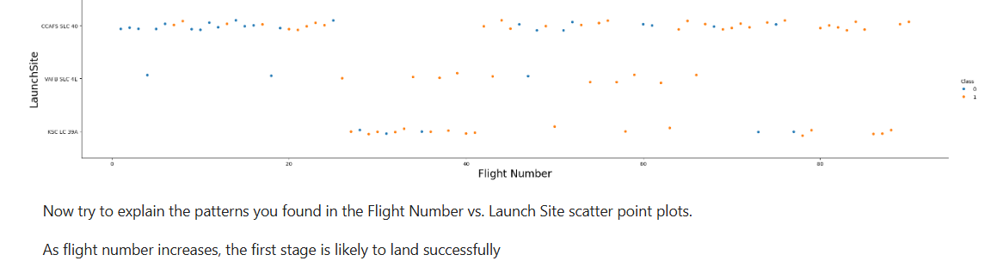
Flight Number vs. Launch Site

Slide 19
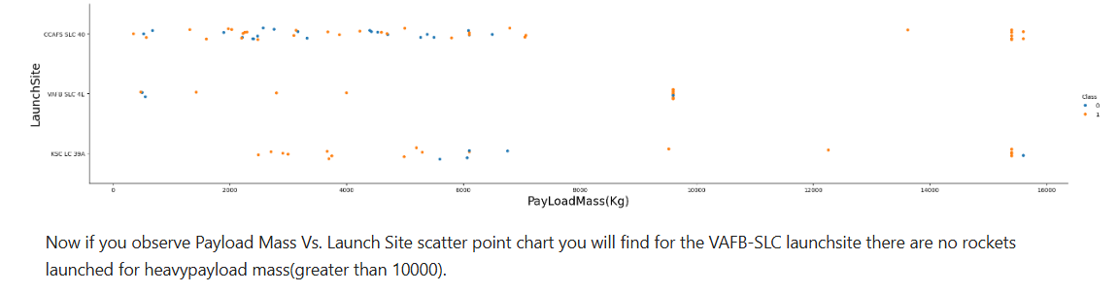
Payload vs. Launch Site

Slide 20
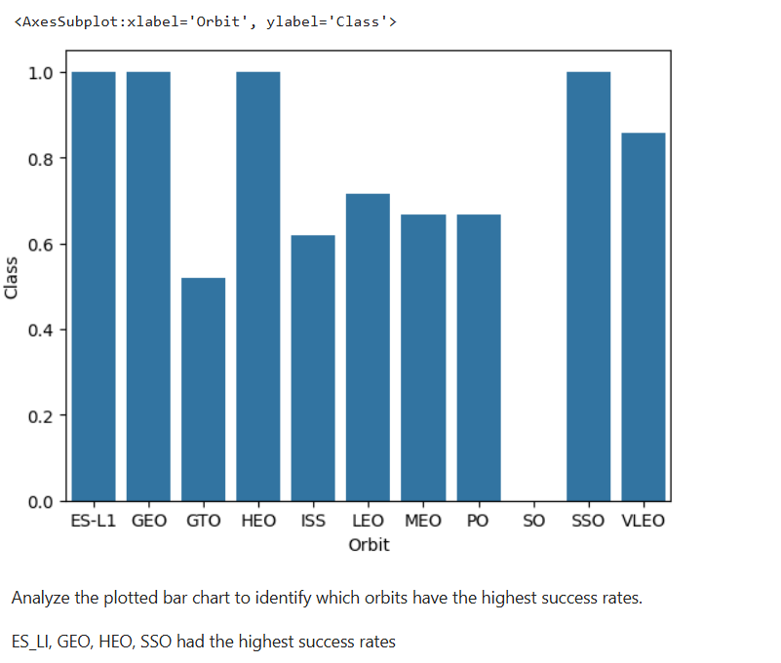
Success Rate vs. Orbit Type

Slide 21
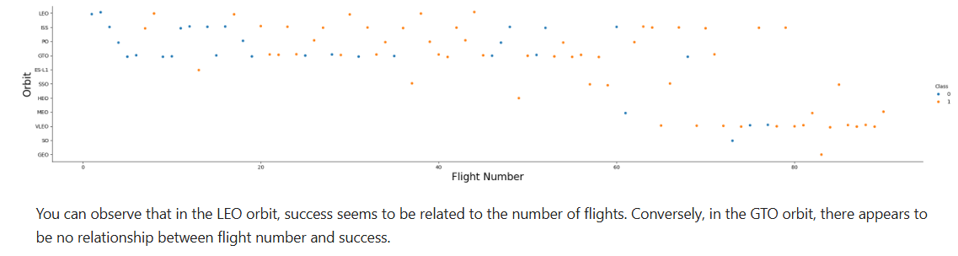
Flight Number vs. Orbit Type

Slide 22
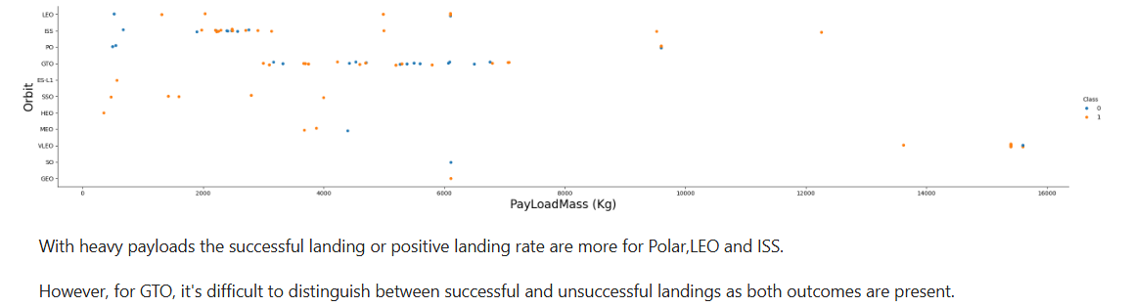
Payload vs. Orbit Type

Slide 23
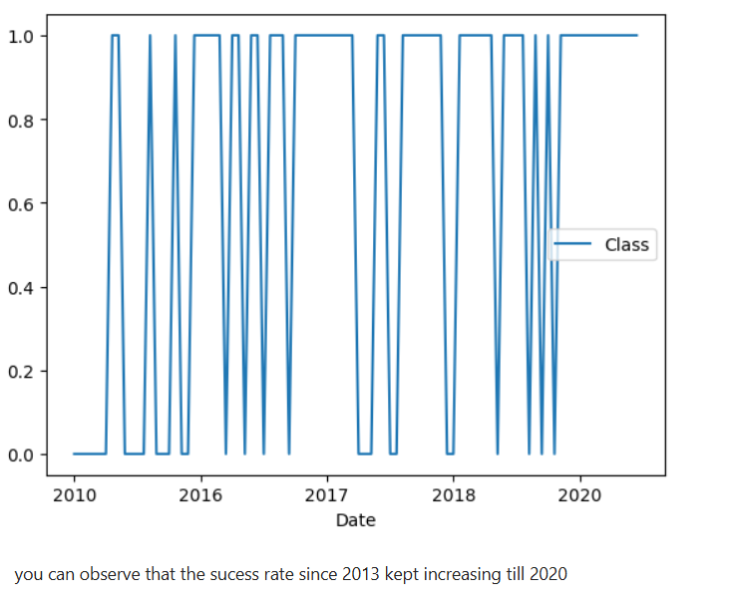
Launch Success Yearly Trend

Slide 24
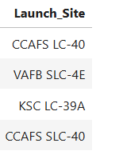
All Launch Site Names
%sql select distinct(Launch_Site) from SPACEXTABLE
Four distinct launch sites

Slide 25
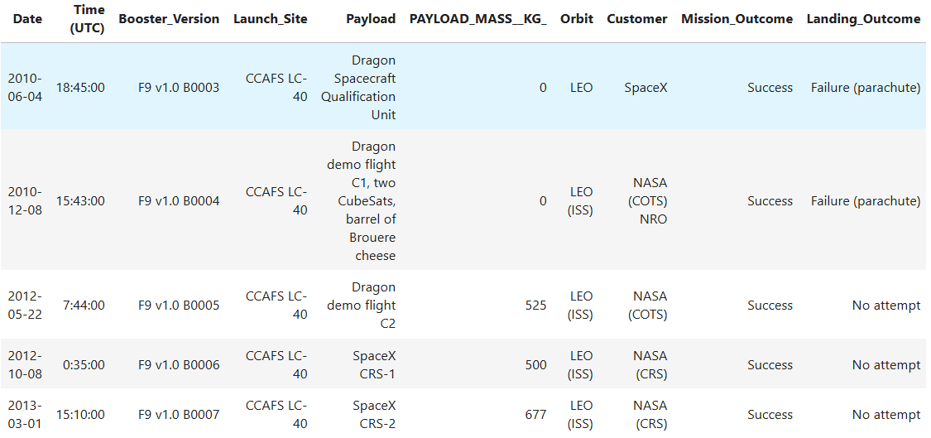
Launch Site Names Begin with 'CCA'
%sql select * from SPACEXTABLE where Launch_Site like 'CCA%' limit 5
5 Records display of launch site CCAFS LC-40

Slide 26
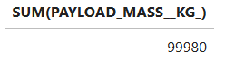
Total Payload Mass
%sql select SUM(PAYLOAD_MASS__KG_) from SPACEXTABLE where Customer like 'NASA%'
Total Payload Mass of 99,980 for all NASA customers

Slide 27
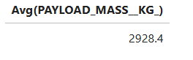
Average Payload Mass by F9 v1.1
%sql select Avg(PAYLOAD_MASS__KG_) from SPACEXTABLE where Booster_Version == 'F9 v1.1'
Average Payload Mass for Booster Version is 2,927.4

Slide 28
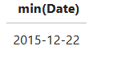
First Successful Ground Landing Date
%sql select min(Date) from SPACEXTABLE where Landing_Outcome == 'Success (ground pad)'
First Successful Ground Landing Date was December 22nd 2015

Slide 29
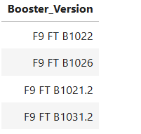
Successful Drone Ship Landing with Payload between 4000 and 6000
%sql select Booster_Version from SPACEXTABLE where Landing_Outcome == 'Success (drone ship)' and PAYLOAD_MASS__KG_ between '4000' and '6000'
Names of successful drone ship landing boosters with payload between 4000 & 6000

Slide 30
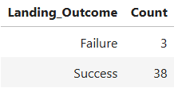
Total Number of Successful and Failure Mission Outcomes
%sql select Landing_Outcome, count(Landing_Outcome) as Count from SPACEXTABLE where Landing_Outcome in ('Success', 'Failure') Group by 1
Total number of successful and failure missions

Slide 31
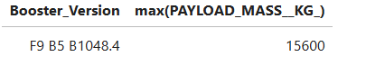
Boosters Carried Maximum Payload
%sql select Booster_Version, max(PAYLOAD_MASS__KG_) from (select Booster_Version, PAYLOAD_MASS__KG_ from SPACEXTABLE) as Table1
The above booster carried maximum payload

Slide 32
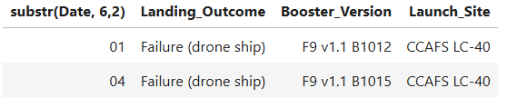
2015 Launch Records
%sql select substr(Date, 6,2), Landing_Outcome, Booster_Version, Launch_Site from SPACEXTABLE where Landing_Outcome == 'Failure (drone ship)' AND substr(Date,0,5)='2015'
Two Launches in 2015, One in January and the other in April

Slide 33
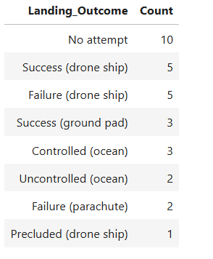
Rank Landing Outcomes Between 2010-06-04 and 2017-03-20
%sql select Landing_Outcome, count(Landing_Outcome) as Count from SPACEXTABLE where Date between '2010-06-04' and '2017-03-20' Group by 1 order by 2 desc
Landing outcomes ranking between 2010-06-04 and 2017-03-20

Slide 34

Section 3

Slide 35
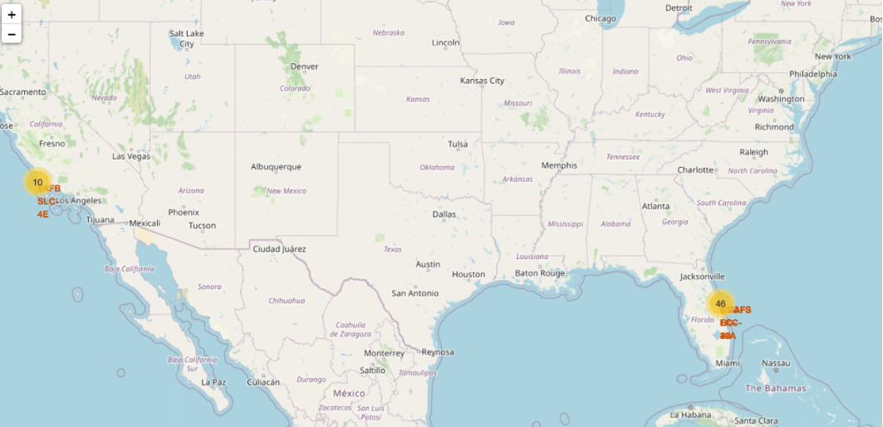
Global Map Launch Sites Location Marker
Location marker to help explore location launch sites showing a total of 56 Launch sites with 46 near Florida and 10 near Los Angeles

Slide 36
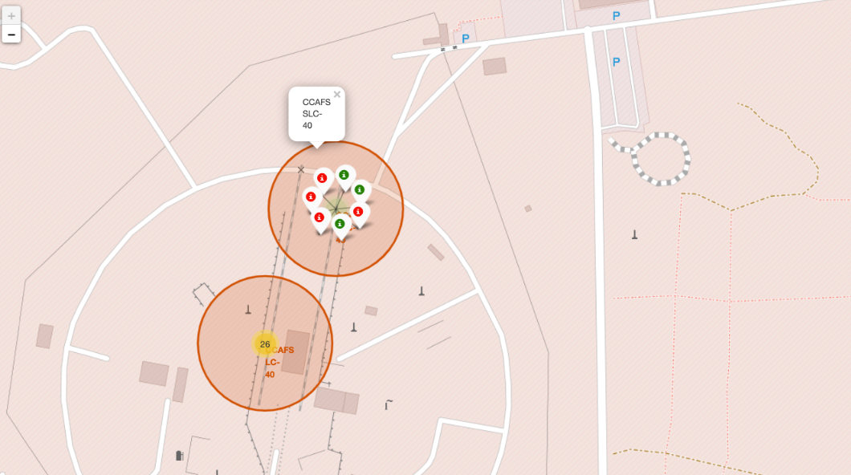
Color Label Launch Outcomes
Color Label Launch Outcomes to help easily identify which Launch Sites have relatively high success rate.

Slide 37
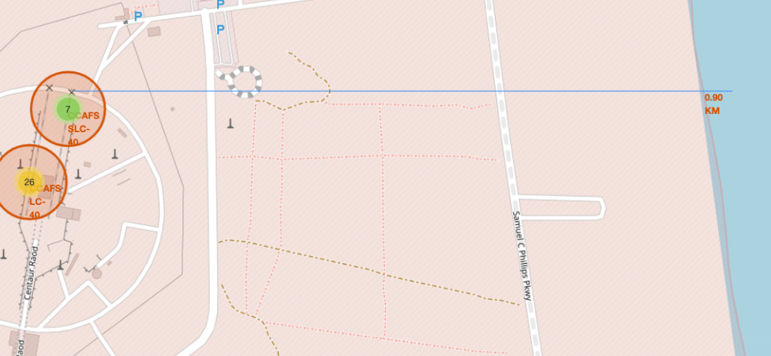
Launch Sites Proximities
Selected launch site to its proximities such as railway, highway, coastline, with distance calculated and displayed

Slide 38

Section 4

Slide 39
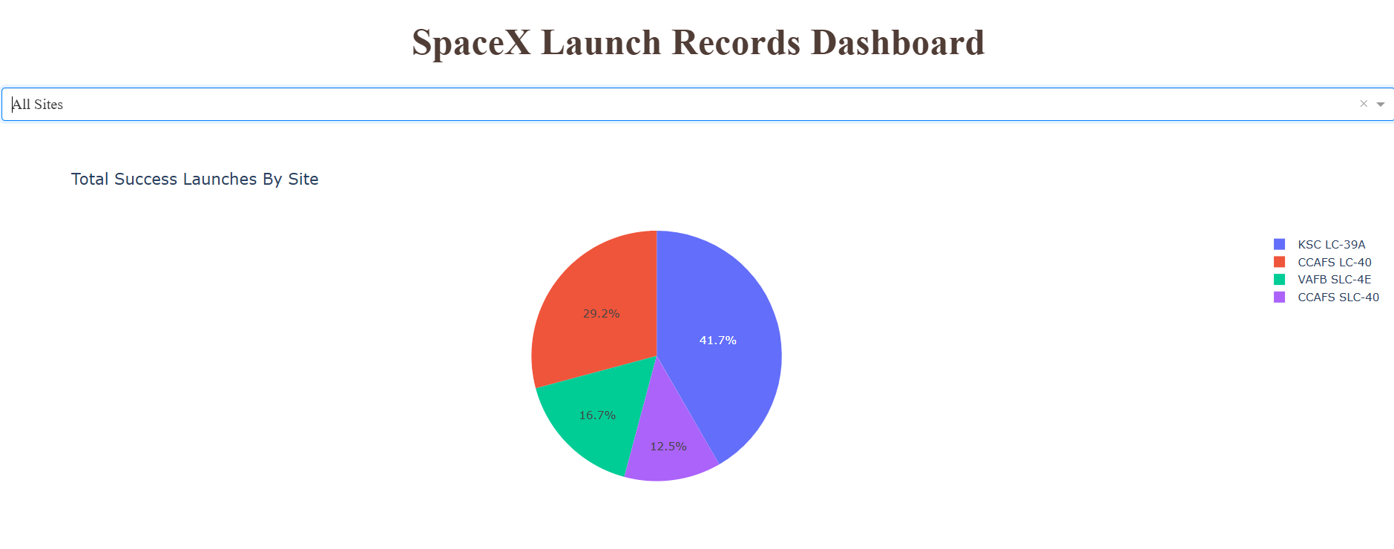
All Sites Launch Success Ratio
Launch Success Ratio for all sites with CCAFS SLC-40 as the lowest and KSC LC-39A as the highest.

Slide 40
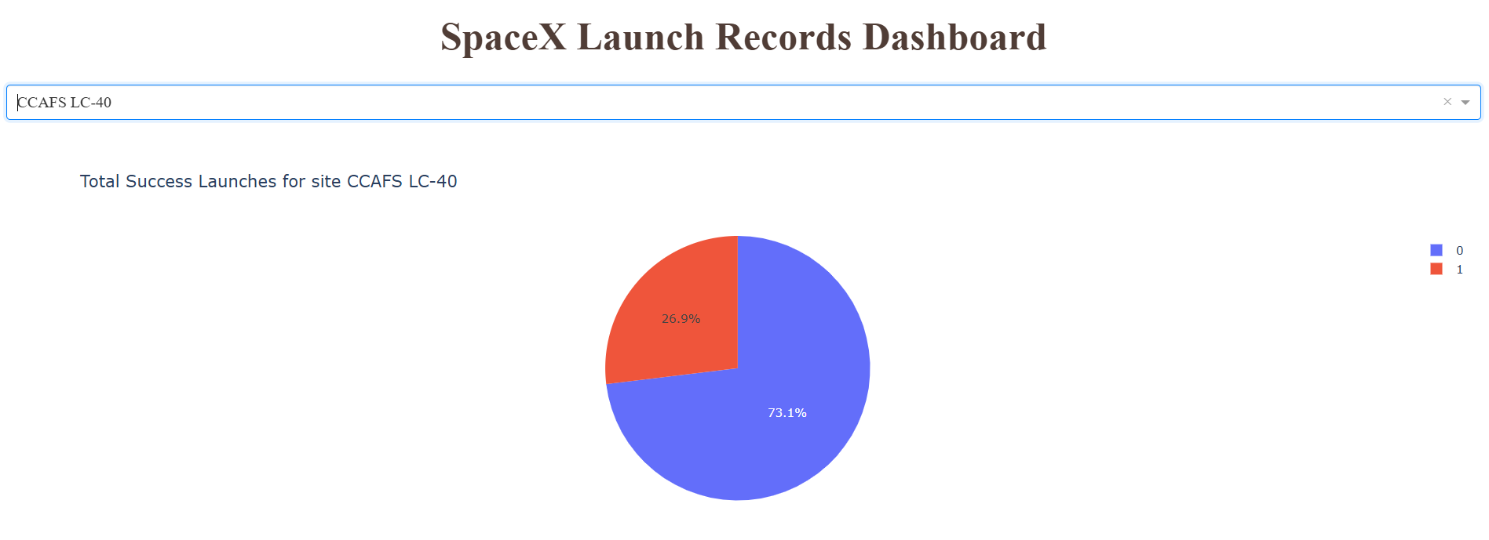
CCAFS LC- 40 Launch Success Ratio

Slide 41
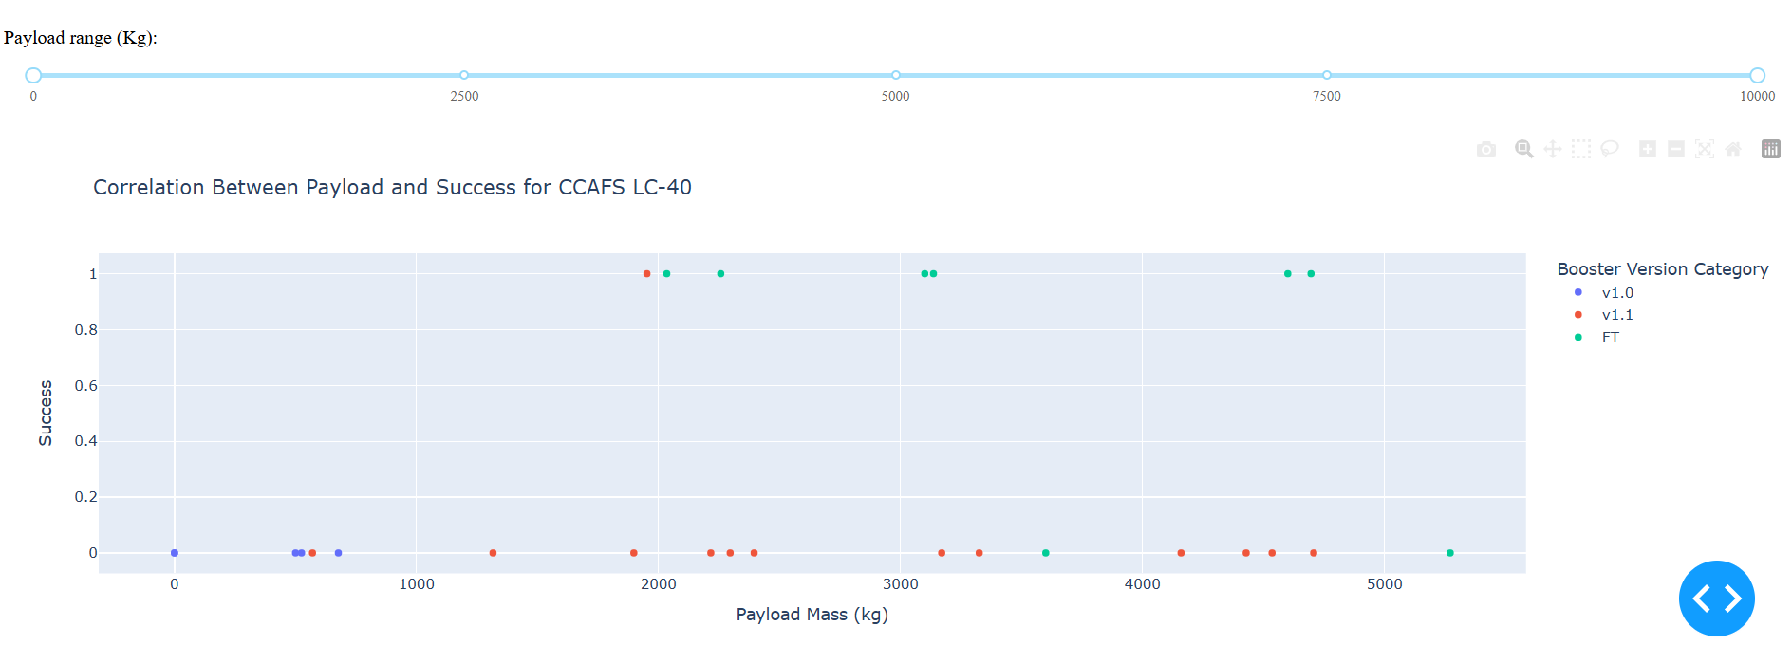
Payload vs. Launch Outcome Scatter Plot
Booster Version F showed a high success outcome at Payload between 2000 -5000

Slide 42

Section 5

Slide 43
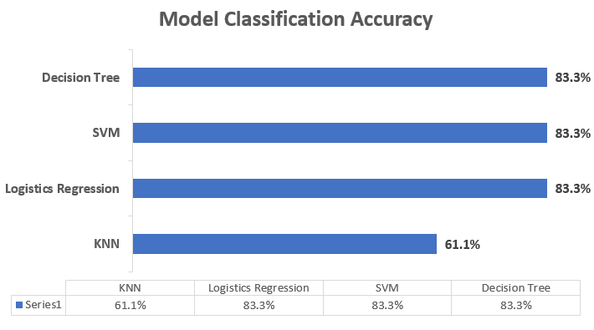
Classification Accuracy
Decision Tree, SVM and Logistic Regression all had same classification accuracy of 83% as the highest

Slide 44
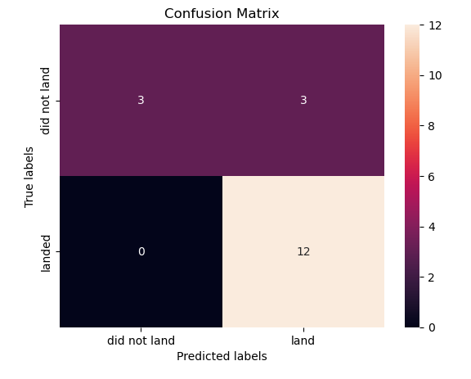
Confusion Matrix
It shows model can distinguish between the different classes, the only problem is the true positive which depicted that 3 landed when it did not land.

Slide 45
Conclusions
Launch Site Success Analysis:
Four distinct launch sites were identified, with CCAFS SLC-40 having the lowest success ratio and KSC LC-39A achieving the highest success ratio​.
Payload Trends:
Total payload mass carried by NASA customers amounted to 99,980 kg​.
The average payload mass for booster version F9 v1.1 was 2,927.4 kg​.
Significant Milestones:
The first successful ground landing occurred on December 22, 2015​.
Successful drone ship landings were achieved for payloads between 4,000–6,000 kg​.
Performance of Boosters:
Certain boosters carried maximum payloads, highlighting technological advancements​.
Machine Learning Insights:
Classification models like Decision Tree, SVM, and Logistic Regression achieved the highest accuracy at 83%​.
Confusion matrix analysis indicated issues with true positives, reflecting challenges in distinguishing specific outcomes​.

Slide 46
Appendix
Datasets dataset_part_1.csv
dataset_part_2.csv
dataset_part_3.csv
ML_data.csv
Spacex.csv
Machine Learning Notebook ML Notebook

Slide 47


